Slide 1
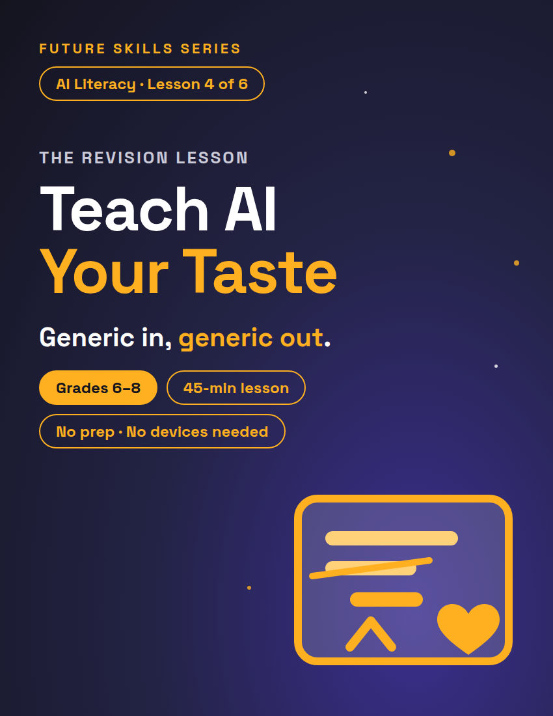
FUTURE SKILLS · AI LITERACY
THE REVISION LESSON
Teach AI Your Taste
Your For-You Page didn't guess your taste — you taught it, one like at a time. Today you write your taste down on one page, then use it to make YOUR OWN writing better.
Grades 6–8
45-min lesson
No prep · No devices needed
1 / 13
Notes:
Open on this slide while students settle. Worksheet: My Taste File + The Editor's Chair, 3 pages, one per student. Deck follows the lesson plan block for block; minute chips top-right match it.

Slide 2
FUTURE SKILLS · AI LITERACY
6 MIN
Warm-Up — The Algorithm Knows You
Raise your hand if your feed knows you a little too well.
Two people download the same app on the same day.
A month later: one feed is all horror edits, the other is all cooking videos.
The app didn't guess. How did it learn?
2 / 13
Notes:
Take 2–3 answers. Land on: every like, skip, rewatch and follow is a signal. You taught it your taste — and the more precisely you signal, the better the feed serves you. Your feed is your taste, written down in likes and skips. WHAT IF a student says 'my feed is random': 'Random is a signal too — what do you skip in the first second? That's a like in reverse.' Nobody raises a hand? Name your own feed first.

Slide 3
FUTURE SKILLS · AI LITERACY
Here's the other side
?
Unless you tell it — or it has saved notes about you — an AI doesn't know your taste. So how does it learn?
3 / 13
Notes:
ANSWER (say it, don't show it): the same way the feed did — you teach it. Bridge, verbatim: "Here's the other side. Unless you tell it — or it has saved notes about you — an AI doesn't know your taste. Today you write your taste down on one page, and then you use it to make YOUR OWN writing better." TRANSITION: "So what happens when the editor knows nothing about you? Watch."

Slide 4
FUTURE SKILLS · AI LITERACY
8 MIN
Generic In, Generic Out
1
2
3
Generic in, generic out
The Taste File
The editor loop
Ask "give me feedback on my paragraph" and you get notes for a generic writer: "add detail." True for anyone, useful to no one.
One page: your tone, formats, pet peeves, one "so me" sentence. Hand it to any editor and the notes finally fit YOU.
YOU draft → editor gives notes → YOU revise. The human does the writing at both ends.
4 / 13
Notes:
Three beats, in order. Beat 2, if your class did the genie lesson: the taste file is your Requirements, written once so you never retype them. Beat 3 — say it plainly: "AI is your editor, not your ghostwriter." Then advance to watch one get fixed.

Slide 5
FUTURE SKILLS · AI LITERACY
Watch one get fixed
GENERIC NOTE
TASTE-FILE NOTE
"Make it more interesting."
"Your taste file says funny and blunt — sentence 2 sounds like a homework robot. Say it like you'd text it."
5 / 13
Notes:
Ask: which note could you actually act on? The right-hand note points at the writer's own taste file — that's the whole difference between a note for a generic writer and an editor's note. WHAT IF 'the AI I use already knows me': 'Some tools do save notes about you. A fresh chat usually doesn't — and either way, a taste file is the fastest way to make sure the notes fit.'

Slide 6
FUTURE SKILLS · AI LITERACY
“
AI is your editor, not your ghostwriter.
An editor gives notes on YOUR writing. A ghostwriter writes it for you.
6 / 13
Notes:
Say it plainly: a ghostwriter writes it for you and lets you put your name on it. Today, nobody in this room is a ghostwriter — not a partner, not an AI. Then move on. TRANSITION: "Page 1. Your taste, written down — five sections, twelve minutes, solo. Nobody swaps anything yet."

Slide 7
FUTURE SKILLS · AI LITERACY
12 MIN
Activity 1 — Build Your Taste File
Section 1 — The Vibe: check the 3 tone words that sound like you, add one of your own.
Section 2 — How I Like It Served: check every format you actually enjoy reading.
Section 3 — Pet Peeves: "Editor, never do this to my writing..." Write two.
Section 4 — So Me / Not Me: your weekend in your voice, then as a robot, a textbook, or a fancy poet.
Section 5 — What I'm Into Right Now: the feel of the music, shows and games you like.
7 / 13
Notes:
Solo on worksheet page 1. Circulate and push for specifics: "quiet" beats "good"; "don't make me sound like a textbook" beats "be nice." WHAT IF stuck on So Me: "Read me the last text you sent a friend. That's your voice." Minute 10: two volunteers read a So Me sentence — the class hears how different real taste sounds. TRANSITION: "Flip to page 2. Three to four sentences: the About Me for a channel or profile you'd really make. Match your taste file. Solo — five minutes."

Slide 8
FUTURE SKILLS · AI LITERACY
15 MIN
Activity 2 — The Editor's Chair
1
Draft it yourself · 5 min
Solo, page 2, Step 1. 3–4 sentences: the About Me for a channel or profile you'd really make. No AI, no partner.
2
Editor's notes · 5 min
Swap ALL pages. Read THEIR taste file, then write 2 notes on THEIR page 2 — each names a section. No rewriting. Then talk for 1 minute.
3
Revise it yourself · 5 min
Swap back. Rewrite your own draft on page 3. Star (*) every change. Your editor does not write a single word for you.
8 / 13
Notes:
DRAFT — WHAT IF 'I don't have a channel': "The one you WOULD make — a game name, a team, a club, a pet's account." TRANSITION: "Pens down. Swap ALL your pages with your partner. You are now their editor — and page 1 is the only thing you're allowed to know about them." NOTES (3 min writing): put the next slide up. WHAT IF the editor rewrites: "You're the editor. Hand the pen back." No section number: "Which section? No section, no note." With devices: run Step 2 once on YOUR projected account — one volunteer's taste file and draft in the copy-ready prompt (Teacher Guide) — and the class checks whether each note names a section. Students never need an account. TRANSITION at 3 min: "Editors, pens down. Read your two notes out loud to your writer. Writers, one question." Then: "Swap back. Page 3 — your draft, your pen. Star every change."

Slide 9
FUTURE SKILLS · AI LITERACY
What a good note looks like
WRITES IT FOR YOU (REJECT)
EDITOR'S NOTE (ACCEPT)
"Make it funnier. Say: 'Welcome to my chaotic channel!'"
"Section 3 says no textbook voice — 'I enjoy various hobbies' is textbook voice. Which hobby, said your way?"
9 / 13
Notes:
Leave this up while editors write. Three rules: use only the taste file, exactly 2 notes, notes not rewrites. The second the editor writes a sentence, they've become a ghostwriter. Second exemplar pair for the board if needed — reject: "It's good. Maybe add more." accept: "Section 2 says short and punchy — sentence 3 is 22 words. Which half matters?"

Slide 10
FUTURE SKILLS · AI LITERACY
Talk it through — 1 minute
Editor: read both notes out loud.
Writer: ask ONE question — "Which sentence?" or "What would fit?"
Editor: answer using only the taste file.
Then swap back.
10 / 13
Notes:
This is the SL.6.1 moment. Sample 3–4 pairs: listen for the answer to cite a section ("Section 3 says no textbook words"), not the editor's own taste ("I'd just make it funnier"). WHAT IF the writer argues back: "Ask which sentence, not whether." Both check checklist row 4 on page 3 afterwards.

Slide 11
FUTURE SKILLS · AI LITERACY
Editor's Loop Checklist
I wrote the first draft myself — no AI, no copying.
Each note names a taste-file section and says what to change — not "make it better."
I rewrote it myself and starred every change.
We talked it through: notes read aloud, one question, an answer from my taste file.
11 / 13
Notes:
Page 3, after the revision. Students check all four before the Last Check. Rows 1 and 3 verify ISTE 1.6.b (own draft, own revision — check against the handwriting and the stars); row 4 verifies the talk you sampled. WHAT IF a student changed nothing: "Your editor pointed at section 3. Read that section out loud. Now change one sentence to match it." TRANSITION: "Checklist — four checks. Then the Last Check at the bottom: three answers, your own words, four minutes."

Slide 12
FUTURE SKILLS · AI LITERACY
4 MIN
Last Check — page 3, your own sheet
One change I made: the old words → the new words.
It fits my taste file because… (name the section).
Why would the note "make it better" NOT have helped you?
12 / 13
Notes:
Solo, 4 minutes. Collect. KEY — #1: quotes the old words and the new words ("I made it funnier" without the words = redo). #2: names a section and the match: "Section 1 says blunt; the new line is blunt." #3 (Objective 1): proficient = "make it better" names no sentence and no direction — better for whom? — while the real note named a section and a sentence. Jaylen exemplar: "'I enjoy various hobbies' → 'I lose at games and cook worse.' Section 3 says no textbook words. 'Make it better' doesn't say what's wrong or what better means for ME." WHAT IF "I made it better": "Which word changed? Write the old word and the new one."

Slide 13
FUTURE SKILLS · AI LITERACY
You draft. The editor gives notes. You revise.
Every AI job runs human → AI → human: you draft, the AI gives the notes, you revise. Write your taste down precisely and every editor — app, AI, or human — finally serves YOU.
13 / 13
Notes:
Close on this. Next in the unit: Robots Do the Boring Work (Lesson 5 — in the unit bundle, or sold separately). This lesson stands alone either way.

